Slide 1
Communicate | Connect | Share
BY JYOTI SAUNA
JUNE, 2016

Slide 2
AUTISM SPECTRUM DISORDER
is a brain disorder that limits a person's ability to communicate and relate to people

Slide 3
Autism is one of the fastest-growing developmental disorders in the U.S. and affects 1 in 68 children. Research has shown that teenagers with Autism Spectrum Disorder (ASD) have a greater risk of depression and suicide than their peers. With their lack of communication skills, teens with autism have difficulty expressing how alone and frightened they feel.
Sources: AutismSpeaks; Psychology Today;
Center on Secondary Education for Students with ASD (CSESA)

Slide 4
Findings from RESEARCH AND interviews with parents and caregivers

Slide 5
While some of the individuals were verbal and others were not, they were all averse to verbal communication.
All users were difficult to motivate with common incentives: money, peer pressure, praise, pop culture etc.
All users enjoyed electronics and could spend hours on their device.
Fascination with maps, routes, number games, movies, watching sports, listening to or playing music were a recurring theme.
Nearly all interviewees thought that playing on their devices would be incentive enough to get the users to complete a task or activity.

Slide 6
“
So many of these kids have auditory processing problems and it’s very difficult for them to listen to one person and then have someone else ask the question. There’s a tremendous appeal to a technological device; especially something which is visual. They tune into it. It’s a high motivator.
- Speech Therapist
“

Slide 7
“
He loves a challenge. If he had to (nonverbally) answer questions to get to the next level in his favorite activity, the challenge itself would be a reward.
- A mother
“

Slide 8
MAJOR TAKE-AWAYS
Clean, simple and consistent interface.
Few choices to avoid anxiety.
Simple navigation that does not require caregiver assistance.
Make interactions challenging and engaging.

Slide 9
HIS STORY: Ryan has ASD. He has mild to medium speech and language impairments and some developmental disabilities. He graduated Special Needs School and now works at a facility for special needs young adults. He follows directions, and is diligent in his work. He is averse to social interaction, verbal communication and making eye contact. Ryan ordinarily plays on his iPad at least once a day and usually spends an hour or two on it. TECHNOLOGY LEVEL: Can type, use an iPad, use a computer INTERESTS: Google Earth, Routes/Maps, Movies, Tennis, Basketball
PERSONA
NAME: Ryan Anderson GENDER: Male AGE: 22 FAMILY: Mom, Dad, Sister

Slide 10
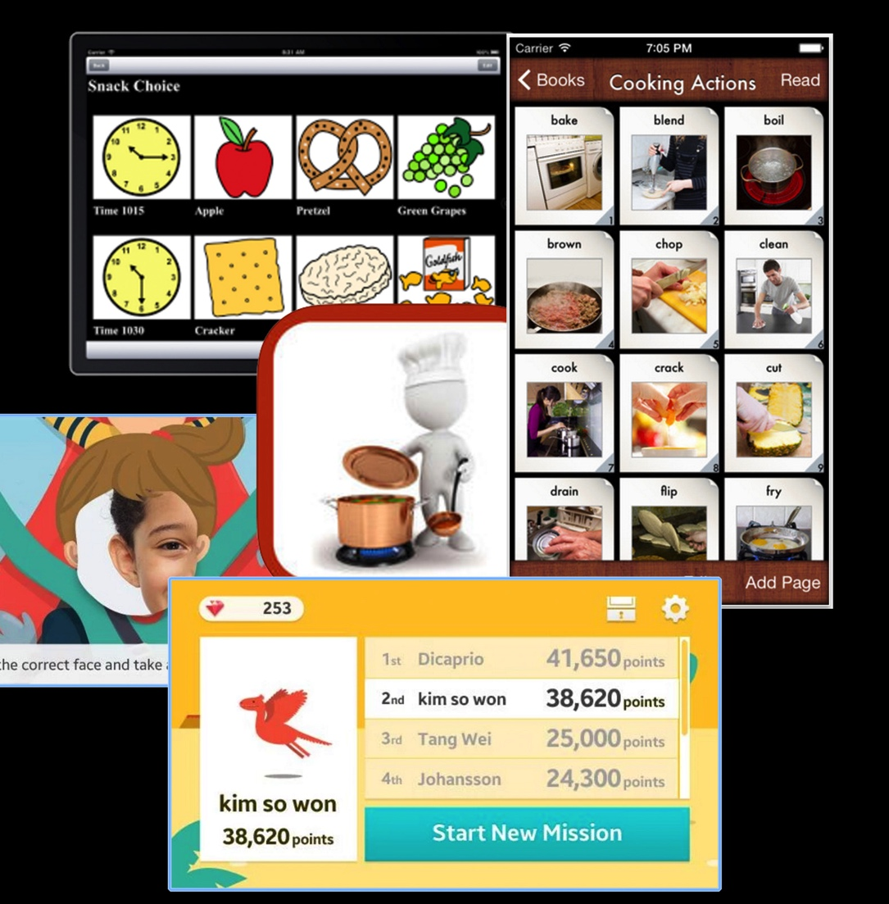
There are numerous apps and resources to help children with ASD, but few that are focused on the needs of teens and young adults. The games and activities are often too childish or address behaviors prevalent in younger individuals. Many of the available apps have confusing interfaces and would require parental or caregiver assistance to use. Most of the apps don’t provide adequate incentive for independent use.
THE COMPETITION

Slide 11
The aim is to target areas of interest and familiar activities and leverage them to develop and enhance communication between teens and young adults with ASD and their families and caregivers. Reach! would integrate with other established apps to create a seamless and fun experience.
THE SOLUTION

Slide 12
USER FLOW
PARENT/CAREGIVER
SELECT ACTIVITIES
CUSTOMIZEACTIVITIES
Parents/caregivers select 2-3 apps that they know their kids already love and interact with. They can personalize and customize the app to their child’s ability.
PERSONALIZE
INDIVIDUAL WITH ASD
The primary user would have to answer 3-4 questions every 15 minutes to continue with the activity of their choice.
SELECT ACTIVITY
INTERACT
ANSWER QUESTIONS
END ACTIVITY
REPEAT
BOTH
At the end of the session, parents and users can review the activity.
They have the option to either read or use a text-to-voice simulator. This would allow the users to feel a real sense of communication without having to get out of their comfort zone or having to go through the anxiety of verbalizing.
COLLECT DATA
REVIEW ANSWERS

Slide 13
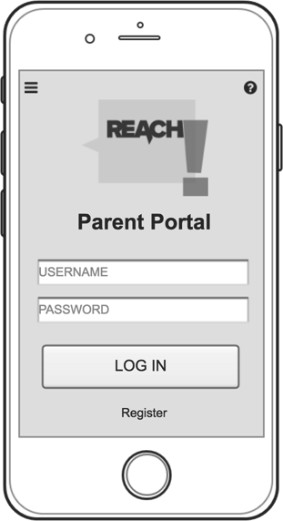
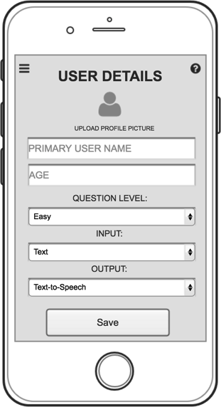
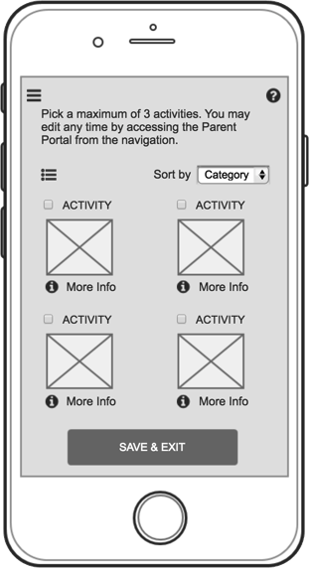
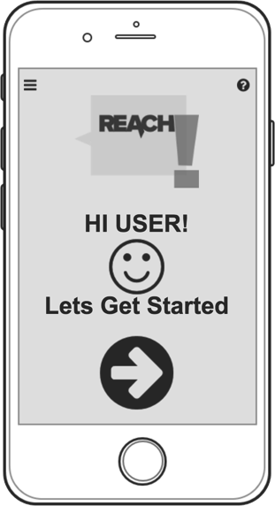
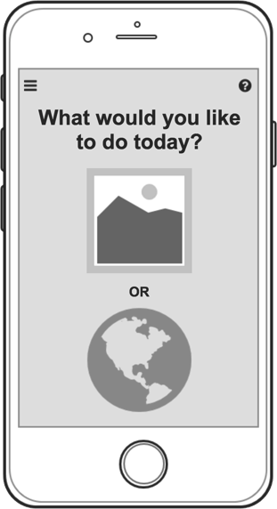
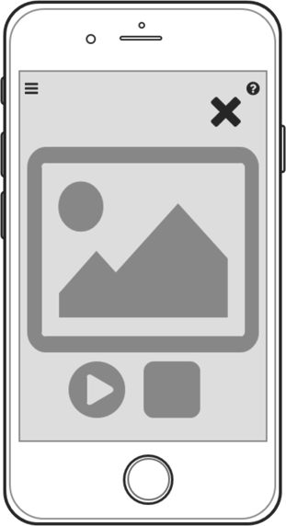
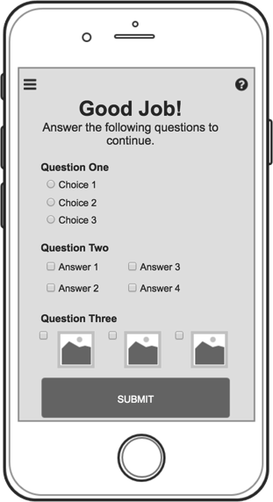
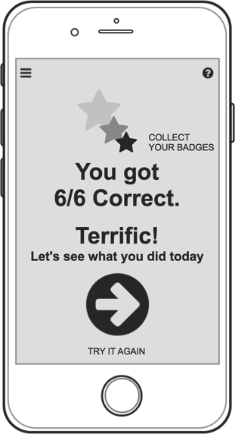
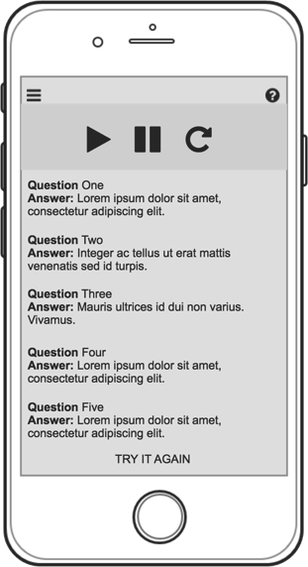
WIREFRAMES
These interactive storyboards were created using Axure and include 3 distinct portals, customization, interaction, and review.
PARENT PORTAL
USER PORTAL
REVIEW

Slide 14
Major hurdles revealed:
CARD SORTING & USER TESTING
Testers were confused by labels “Parent” and “User” Or “Admin” and “Primary User”
The 2 portals – Admin Portal and User Portal were also very confusing.

Slide 15
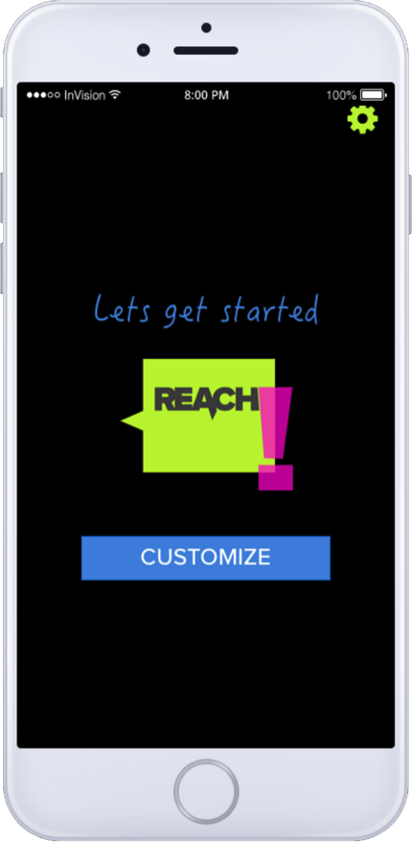
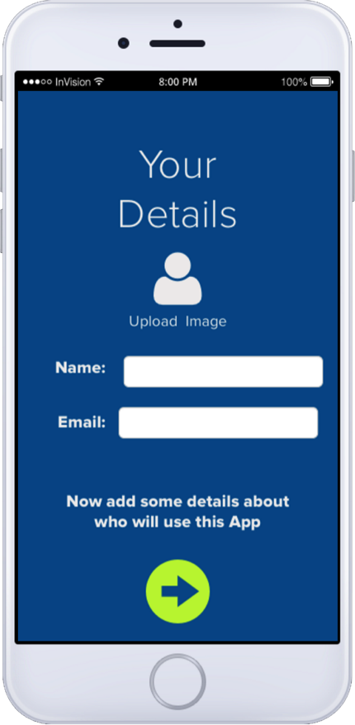
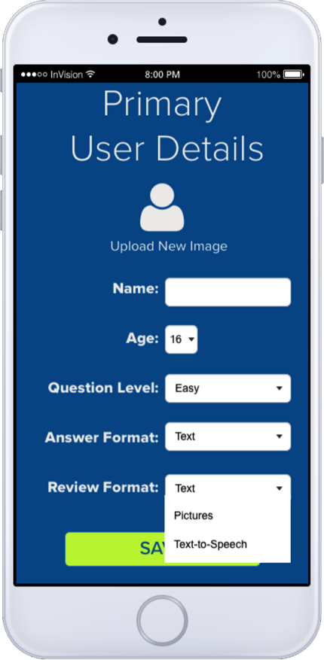
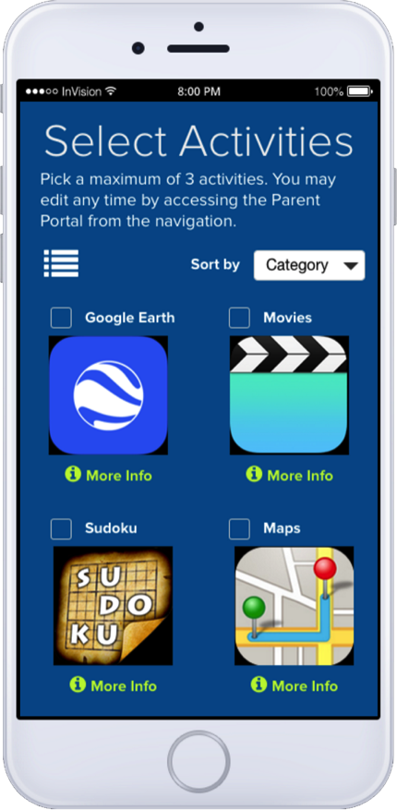
ALTERING AND REORGANIZING
Removed the confusing “Portals” and instead added a “Settings” icon from where the Customization and Personalization screens would be accessible.

Slide 16
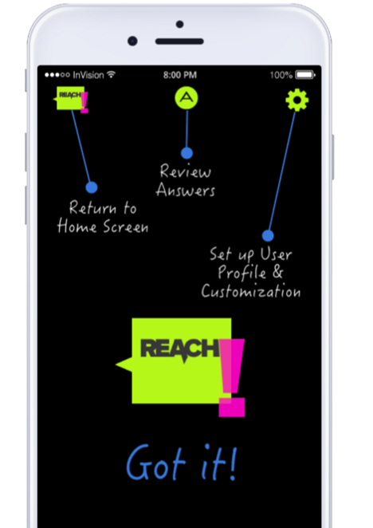
ALTERING AND REORGANIZING
Removed the menu which was redundant and confusing.
Added onboarding screen to show basic functions of icons in top bar.

Slide 17
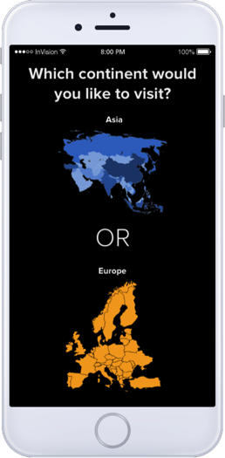
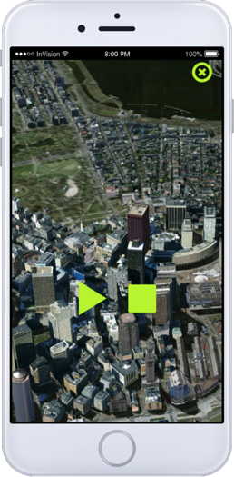
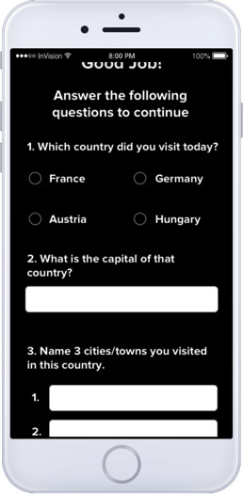
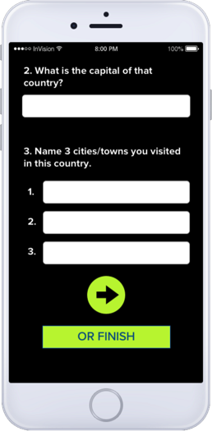
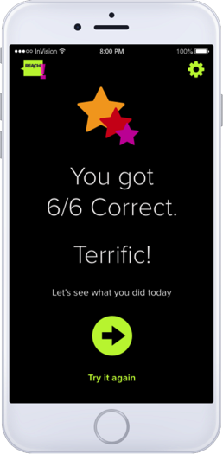
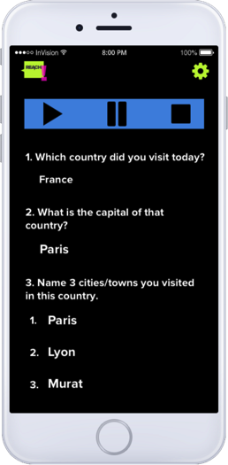
PROTYPING
Interactive prototypes created using inVision which walks the viewer through the user experience:
Selecting an activity
Interacting with it
Answering questions and
Reviewing answers.
Go to Prototype

Slide 18
WHAT NEXT?
STILL NEEDED
Additional User Testing and Tweaking.
Allow parents to add/edit questions.
Make the question-answer activities more fun and interactive.
Add Social Sharing components.
Expand database of compatible games.
Broaden the scope of the app to embrace different situations. For example, communicating with supervisors at work.
LONG TERM

Slide 19
MAKING A DIFFERENCE
Live Links:
Wireframes (Axure)
Prototype (inVision)
Thank you!

